Slide 1
Private Data OBJECTS
Smart Contracts For Data Access AND MORE
Mic Bowman
Intel Labs

Slide 2
Legal Disclaimers
Intel technologies’ features and benefits depend on system configuration and may require enabled hardware, software or service activation. Performance varies depending on system configuration. No computer system can be absolutely secure. Check with your system manufacturer or retailer or learn more at www.intel.com.
Software and workloads used in performance tests may have been optimized for performance only on Intel microprocessors. Performance tests, such as SYSmark and MobileMark, are measured using specific computer systems, components, software, operations and functions. Any change to any of those factors may cause the results to vary. You should consult other information and performance tests to assist you in fully evaluating your contemplated purchases, including the performance of that product when combined with other products.
For more information go to http://www.Intel.Com/performance.
All information provided here is subject to change without notice. Contact your Intel representative to obtain the latest Intel product specifications and roadmaps.
Copyright © 2018 Intel Corporation. All rights reserved. Intel, the Intel logo, Intel Experience What’s Inside, the Intel
Experience What’s Inside logo, Intel Inside, the Intel Inside logo, and Intel Xeon are trademarks of Intel Corporation in
the U.S. and/or other countries.
*Other names and brands may be claimed as the property of others.

Slide 3
Private Data Objects (PDOs)
Private Data Objects enable sharing of data and coordinating action amongst distrusting parties.
  Privacy Preserving Smart Contract
    Access Policy: Smart contract defines data access and update policies
    Confidentiality: Data can only be accessed through SGX enclave executing the smart contract
    Stickiness: Policies are enforced wherever the object resides
  Blockchain-based Ledger
    Commitment: Auditable record of agreements and policy
    Integrity: Ensures that there is one authoritative instance of an object
    Coordination: Guarantees atomicity of updates across interacting objects

Slide 4



Example: Transient-Driver Profiles
Trends
Changing sense of vehicle ownership (long-term owner → short-term lease)
Insurance companies moving to metered services
Solution Requirements
Verifiable and representative log of driver history over all vehicles
Rapid evaluation of that history leading to personalized quotes
Without exposing personal information inappropriately
Driver Profile
Personalized Insurance Quote
Insurance Risk Analytics

Slide 5



Example: Transient-Driver Profiles
Trends
Changing sense of vehicle ownership (long-term owner → short-term lease)
Insurance companies moving to metered services
PDO Solution
Contracts ensure appropriate access to the driver profile
Blockchain provides immutable, verifiable log for profile integrity
Analysis occurs inside enclave to protect data access
Driver Profile Contract
Blockchain
Driver Rating
Contract
Insurance company analytics can be applied to a verifiable driver profile without exposing any personal data about the driver.

Slide 6
Smart Contracts Today
Redundant Compute Replaces Centralized Trust
Compute and Vote
  Every validator executes every update on every transaction
  All of the validators must agree on the result for it to be committed
Single Organization
Centralized Trust
Single Computation
Multiple Organizations
Decentralized Trust
Redundant Computations and a Final Vote
Public, Inefficient, Slow
Notes:
https://coingape.com/ethereum-congestion-intensifies-as-pending-transactions-crosses-90k-mark/
Backlog of 90K messages pending execution
Around 20,000 servers are involved in creating a crypto-kitty with Ethereum
Contract details are public
The agreement and its current state can be seen by everyone
Performance impact can be significant
Trust is in redundancy
No scale-out; single server performance
Contract updates must be deterministic
All validators must compute the same result
Pseudo-random is possible but public state → results are predictable

Slide 7
Smart Contracts Based On Intel SGX
Replace Redundant Compute with Trusted Execution
Compute and Compare
  Update executes in one enclave and produces a proof of correctness
  Other validators verify the proof and accept the update
Single Organization
Centralized Trust
Single Computation
Multiple Organizations
Decentralized Trust
Trusted Computation and Attestation
Private, Efficient, Scalable

Slide 8
Private Data Objects in SGX
How It Works With SGX:
  An SGX enclave executes an operation on the PDO smart contract
  The enclave generates a “proof of correctness” that is verified by the ledger
  The ledger ensures that updates to the PDO are serialized
Implication
  Ledger doesn’t need contract or state
    The contract and its state can be kept private (encrypted and off chain)
  Performance impact is minimal
    Only execute once, SGX overhead
    More servers → better performance!
  Updates need not be deterministic
    No need for global agreement

Slide 9
Access/Use Policy Universally Enforced
  Contract state is always encrypted outside of the enclave
    Even the contract owner cannot see the contract state
    The smart contract may allow externalization of data
  Consequence: access policy is enforced no matter how the data is shared
  This enables some interesting policies
    Differentially private access that doesn’t require the data owner to see the data
    Owner of the data can prove “compliance” to a set of operations on the data
      External bid for a contract job
      Constrained analysis on visual data
    Automated data aging
      De-anonymized research data may be released after 5 years
    Multi-participant, confidential audit
      Verifiable financial transactions
      Information provenance

Slide 10
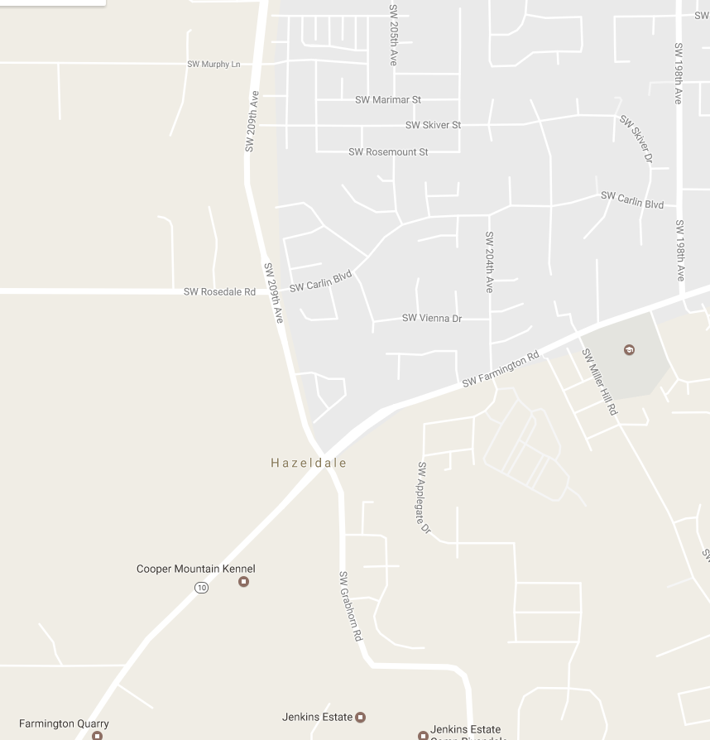
Traffic Planning
Scenario for Information Sharing
  The intersection at Rosedale & 209th backs up every weekday afternoon
  How to solve the problem?
    Put in a stoplight at that intersection (expensive)
    Redirect traffic away from that intersection (possibly less expensive)
  Need source & destination for cars going through the intersection
  But… getting that information is hard… for many reasons
Would you trust your DOT with the knowledge of where you are at all times when you are driving? Even if it would most likely lead to a better commute?

Slide 11
How To Use PDO For Route Data
  DOT implements a smart contract to collect route information from drivers
    Any individual may put route data into the contract
    Any individual may remove from the contract route data they put in
    DOT may only see heat maps of source and destination through a specific intersection
      Contract enforces a form of k-anonymity
    DOT may only request data about (for example) 10 intersections per day
  Observations
    Details of the smart contract are available for public inspection
    Driver data is always encrypted outside of the enclave, even DOT cannot see it
    Analysis of the data occurs through the smart contract inside the enclave
    Driver data can be removed from future use, and the contract can prove that it has been removed
    And… we could add “rewards” for participation if appropriate

Slide 12
Summary
Private Data Objects enable sharing of data and coordinating action amongst mutually distrusting parties.
Status
  Prototype code available through Hyperledger Labs
  Contracts are defined in a functional language evaluated in an enclave
  Contracts for driver profiles, asset markets with fair exchange & auctions
Ongoing Work
  Support more ledgers
  Support additional contract interpreters

Slide 13
Links
DEMO: https://www.youtube.com/watch?v=I1HbFPwo4gg
PAPER: https://arxiv.org/abs/1807.05686
CODE: https://github.com/hyperledger-labs/private-data-objects

