Slide 1
Interoperable City Platform and IES-City Framework
Sokwoo Rhee
Associate Director for Cyber-Physical Systems Innovation
Organized by
National Institute of Standards and Technology
and our partner organizations

Slide 2









IoT-Enabled Smart City Framework
Smart City technologies are being developed and deployed at a rapid pace.
Many previous smart city deployments are custom solutions.
A number of architectural design efforts are underway worldwide but have not yet converged.
NIST and its partners are convening a public working group to distill a common set of architectural features from these architectural efforts and city stakeholders.
Goal: A reference framework for the development incremental and composable Smart Cities

Slide 3

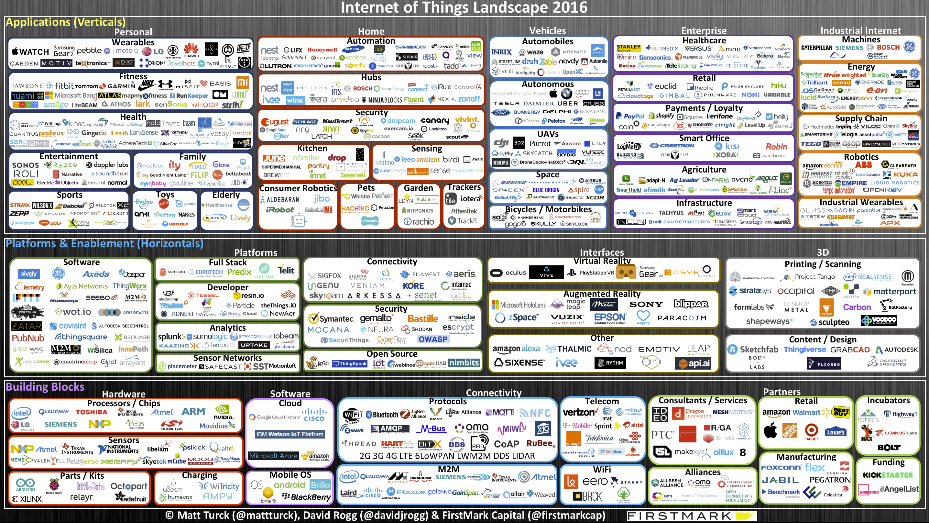
The Challenge - Divergent CPS/IoT Technology Landscape

Slide 4
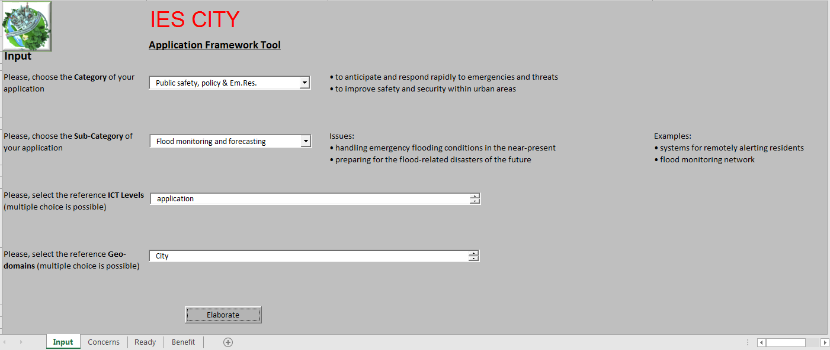

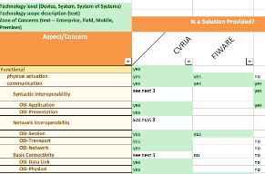
Global City Teams Challenge (GCTC) and IES-City Framework
Municipality
Smart and Secure
Market Driven: GCTC
Action Clusters
Super Clusters
Technology Driven: IES-City Framework
Application Analysis
Technology Suite Analysis
Action Cluster
Provider ecosystem
Application
Super Cluster
Multi-City Action Cluster
Smart America 2014
GCTC 2015 & 2016
GCTC 2017
GCTC SC3 2018

Slide 5
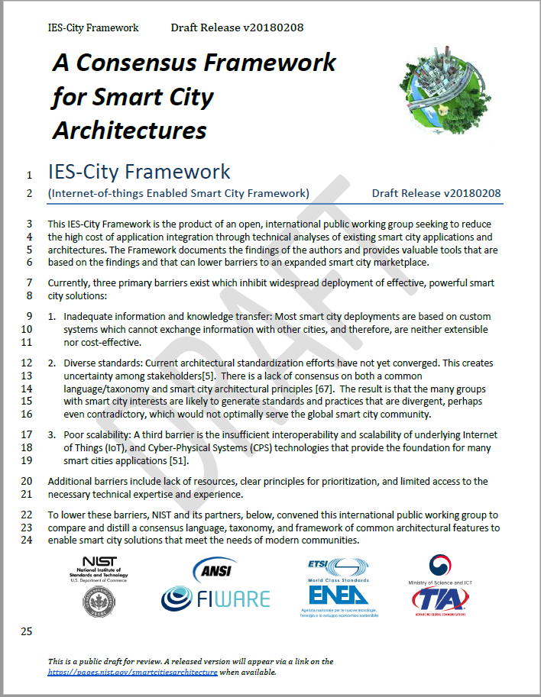
IES-City Framework Consists of:
A Framework Document
Set of Artifacts
+

Slide 6


Pivotal Points of Interoperability (PPI)
Independent technology deployments
With Pivotal Points of Interoperability
PPI
Minimize distance to interoperability
e.g. REST APIs
PPI
e.g. Convert XML to JSON
e.g. TLS 1.2
Potentially large distance to interoperability
PPI
Composable Smart Cities
e.g. IPv6 address
Notes:
http://www.clker.com/cliparts/b/4/1/c/12161792181572247290Peileppe_Decorative_curves.svg.hi.png
http://www.clipartbest.com/clipart-RiA4bG6iL

Slide 7
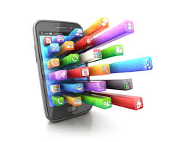

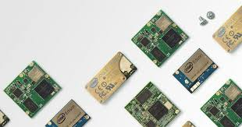
Zones of Concern (ZofC)
ZoC may form key groupings for Application Developers, Infrastructure Providers, and Device Manufacturers
Northbound (Apps)
Trusted WAN Infrastructure
Southbound (Devices)

Slide 8
Technical Analyses Reviews

Slide 9
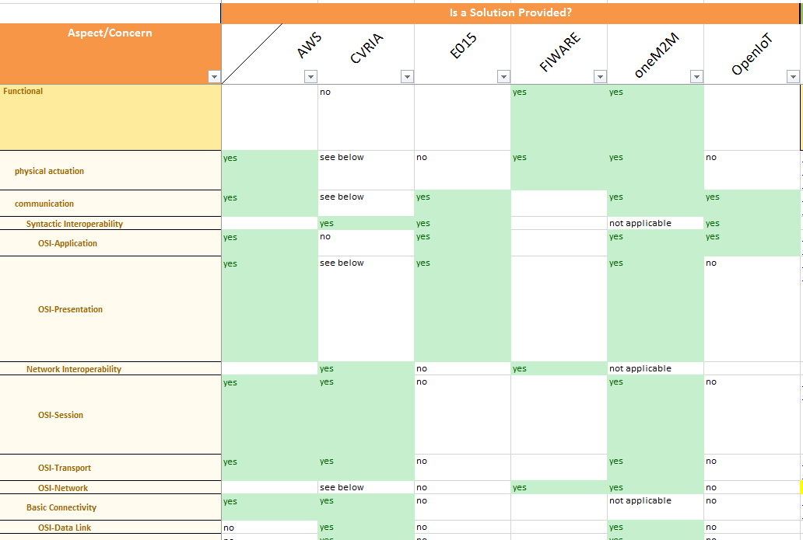
Do they address concerns?
Northbound ZofC

Slide 10
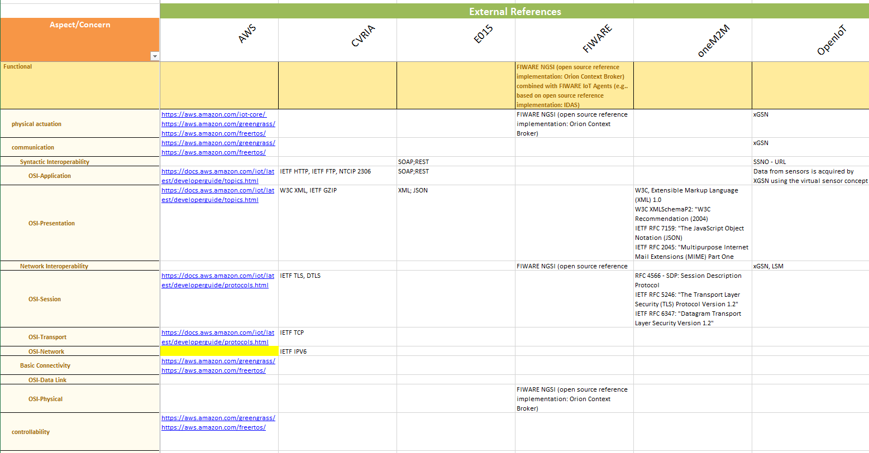
What solutions did they use?
Northbound ZofC

Slide 11
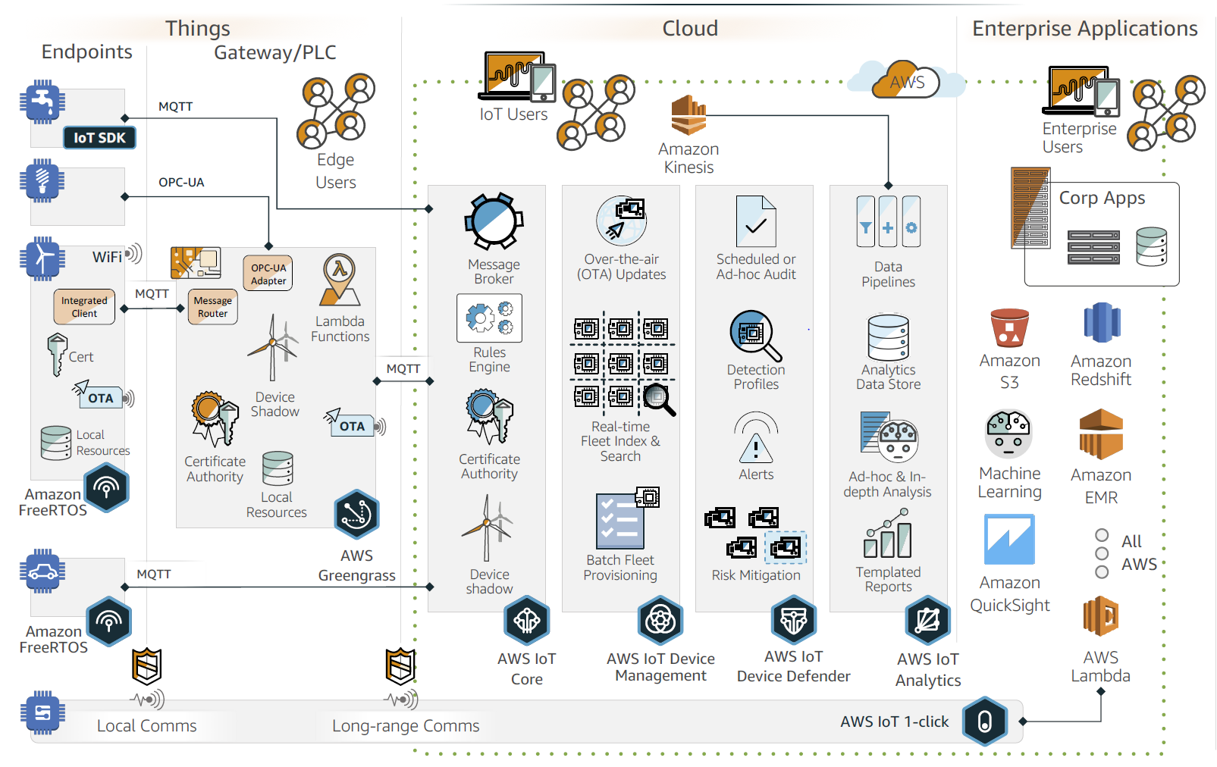
Insert examples of ZofC (Amazon Web Services)

Slide 12

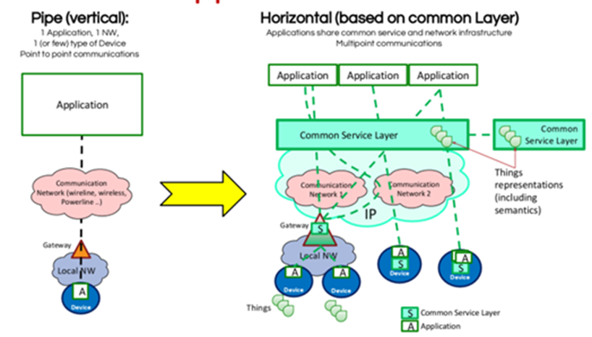
oneM2M ZofC

Slide 13
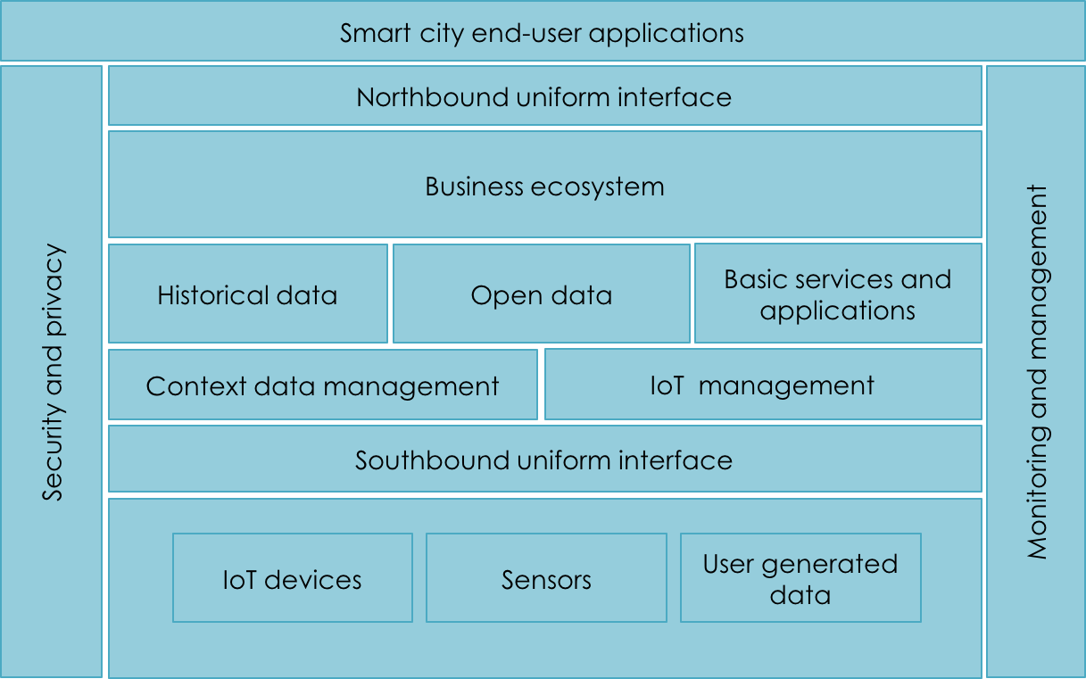
Synchonicity: ZofC

Slide 14
ESPRESSO ZofC
Access Services and
Domain Services
Appl Zone
Data Lake
Data Zone
IOT/CPS
Other
Device Zone

Slide 15
ApplicationFramework Tool

Slide 16
Smart City Application Framework
Objectives:
Evaluating a list of cases that they are implementing in order to better manage their resources and deliver services to their citizenry.
Identifying the needs and priorities of a city and assess on whether the city is ready from a technical point of view for absorbing "smarts”.
Measuring the benefits that can be expected from the solutions evaluated and/or determine whether the goals (benefits) have been accomplished

Slide 17
Dimension | Description
Breadth: List of applications and related metrics | It consists of both a framework (metrics + tool) for evaluating the breadth (elaborated on the basis of existing models) and the list of evaluated applications
Readiness: A framework for assessing City’s Readiness | A List of Metrics + a tool to Assess the Readiness of Cities to Absorb Smart City Applications (elaborated on the basis of existing maturity models)
Benefits: A Framework to Measure Benefits | Metrics + tool for measuring benefits that can be derived from Assimilated Applications

Slide 18
Evaluate Breadth
Objectives:
Definition of an approach for evaluating the breadth of applications: this approach will be developed starting from some existing models
Definition of a framework for evaluating the breadth of applications: practically this framework will be a software tool, based on the defined evaluation approach.

Slide 19
List of Requirements for the following kind of Smart City applications (Built Environment/ Smart Building)
Aspect | Concern | Abstract requirements | Specific implementation requirements
Functional | Actuation | - to control building energy systems | - actuation capabilities - smart devices
 | Communication | - capacity to exchange information internal to the system | - Home management systems - Sensor network
 | Functionality | - energy management - alarm management - fault detection and diagnosis | - Automation and real-time analytics - integration with utilities and city infrastructure
 | Controllability | - to remotely control/access to the systems | - Internet connection - remote control software
 | Performance | - to provide feedback in time to act | - fast and reliable network - real-time systems
 | Physical context | - to detect presence of people | - sensors (motion, presence, ...)
 | Sensing | - to detect presence of people - persistent communications - to elaborate data received from home energy systems - capacity to analyse and elaborate received data and make decisions | - sensors - persistent communications technologies - decision support systems
 | Monitorability
Human | Usability | - to provide human readable, unambiguous and aggregated data
List of requirements for Smart Building application, involving the data level for geo-domain

Slide 20
Evaluate Readiness
A comprehensive and easy-to-use tool for cities to make a quick and prudent decision to identify and deploy smart city applications.
Concise set of metrics and indicators to measure progress.
Allow a quick, high-level readiness assessment that can be followed up with a much more robust and long-term assessment process.
Assist policymakers in prioritizing actions (i.e. procurement, indirectly highlighting most pressing needs, etc.)
Assist stakeholders in determining, at a first pass, whether a city has an existing infrastructure that will make applications to integrate.
Once a smart city project is engaged, more detailed analytical tool may be needed to aid in the specification and implementation process

Slide 21
List of Readiness Parameters for the following kind of Smart City applications
Category: | Built environment
Sub-Category: | Smart Home
Strategic Intent | Technology | Readiness parameters
Data | Open data/information platform | - Current sources of open data from government services
ICT Infrastructure/Technologies | Internet network | - Substantial percentage of households with internet access - Availability of fixed broadband subscriptions
 | Broadcasting
 | Sensors networks | - Availability of sensors network infrastructure - Substantial percentage of smart phones and tablets
 | Computer/laptop
Governance & Service Delivery Models | Integrated management center
 | Emergency response
 | Services deliveries | - 24/7 ICT Services - Information security of public services and systems - Availability of services to support persons with specific needs - regardless of ability and affordability
Stakeholder Engagement | Citizen Education | - Availability of education program for citizens on smart city applications
 | Web portal/mobile apps/online services | - Most web portals/Apps are universally accessible (also compliant to disabled persons)(support) - Availability of programs for online citizen engagement
Example of set of a complete readiness table for a particular sub-category

Slide 22
Evaluate Benefits
Objectives:
Assist cities to parameterize the necessary investment of public resources for a smart city designation.
Evaluate benefits for deploying possible technologies for all involved stakeholders – public sector (city government), private sector (enterprises/private firms) and citizenry.
Optimize the usage of available capacity and resources to maximize benefits to all.
Instead of striving for physical growth, it is important that cities start to measure how wisely they consume resources, and how well they maintain high quality of life, and how smart they are enable economic prosperity and social equability and environmental sound.

Slide 23
Domains | Categories | Sub-categories
Public Sector | Economic Benefits | Integration
 |  | Employment
 |  | Leverage of private funding
 |  | Prosperity
 |  | Cost saving
 |  | Economic resiliency
 |  | Pricing
 | Environmental Benefits | Energy Conservation
 |  | Water Conservation
 |  | Waste reduction
 |  | Raw Materials conservation
 |  | Environmental Quality
 |  | Ecology System Protection
 |  | Natural Hazard Prevention
 | Social Benefits | Public Service
 |  | Governance
 |  | Equitability
 |  | Attraction
Benefit categories and subcategories for public sector (please see more detailed metrics in the document)

Slide 24
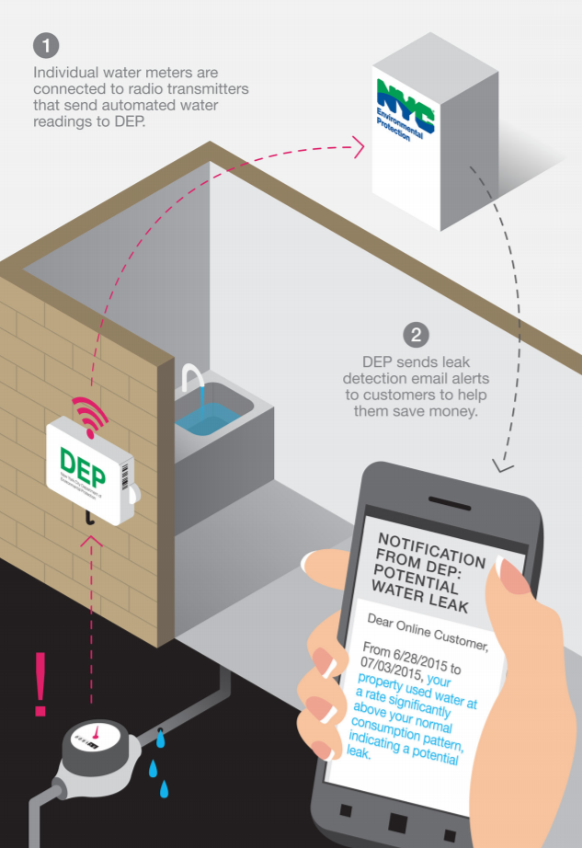
Applications Case Studies
Wireless water meter: New York City's Automated Meter Reading (AMR) system consists of 817000 individual water meters all over the city. Each of them is connected to a low-power radio transmitter that sends water readings to rooftop receivers in a certain frequency. The receivers transmit the data to a Network Operations Center using a secure citywide telecommunication network. Customers can view their water usage data and pay bills online. Thus, saved over $3 million per year by avoiding manual meter readings.
Category/Subcategory: Built Environment / Smart Home
Readiness:
Substantial percentage of households with internet access
Current sources of open data from government services
Substantial percentage of smart phones and tablets
24/7 ICT Services
Information security of public services and systems
Benefits:
Decrease cost in serving citizens
Decrease cost in paying for utility, includes electricity, natural gas and water, etc.
Reduce residential water consumption
Increase residential wastewater recycling and reuse
Promote business development and increase revenue opportunities
Reduce operation and management cost

Slide 25
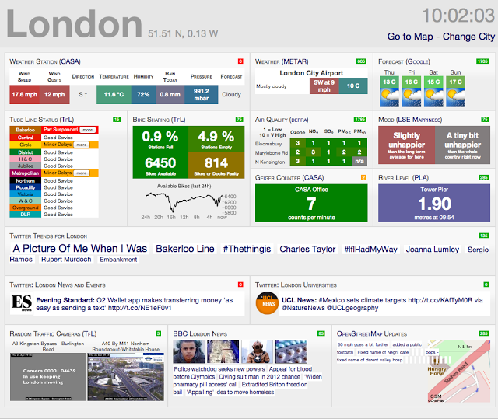
City Open Data Platform: The London Datastore was one of the first platforms in the world to publish open data and make it public accessible. This Datastore receives over 30,000 visits a month and more than 450 transport app has been created using open data. This encourages the development of products new business model, and creation of better, more cost effective, services for all Londoners.
Category/Subcategory: Socio-economic development / E-Governance
Benefits:
Improve economic integration
Provide public-private-partnership opportunities
Promote local GDP Growth
Improve public service deliveries
Improve decision-making process and operation efficiency of governance entity within one department or across others
Reduce cost in governance operation and maintenance
Decrease cost in serving citizens
Enhance governance transparency
Reduce duplication of city effort from different departments with enhanced procurement process
Improve social equitability
Increase city's attraction to residents and visitors
Provide opportunities to enhance public participation in public affairs or activities
Enhance creativity of citizens
Improve community connectivity
Promote business development and increase revenue opportunities
Engage and leverage Small and Medium Enterprises (SME) community
Accelerate new business start-ups
Incubate innovative technologies and accelerate new product disruptions
Readiness:
Current sources of open data from government services
Availability of online city information
Substantial percentage of households with internet access
High City coverage with 3G enabled mobile network
Substantial percentage of smart phones and tablets
Use of Integrated Management & Command Centre
Availability of online city feedback mechanisms
Government access to cloud services
Adult Literacy Rate - High percentage of households with at least one family member who is digitally literate
Most web portals/Apps are universally accessible

Slide 26
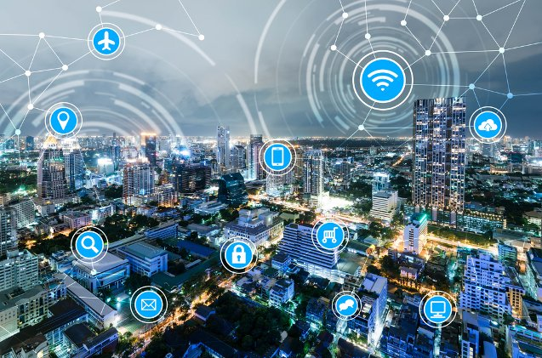
Readiness:
Current sources of open data from government services
Availability of online city information
Substantial percentage of digital broadcasting network
Availability of sensors network infrastructure
Use of Integrated Management & Command Centre
Centralized collaboration between emergency response, police, fire, water, power
Availability of online city feedback mechanisms
Government access to cloud services
24/7 ICT Services
Availability of needed citizen centric services over Mobile Applications/website portal - require support to continuously provide value to users
Most web portals/Apps are universally accessible (also compliant to disabled persons)(support)
Substantial use of social media by the public sector
Smart platform for data management: City of Genoa, Italy uses FIWARE (fiware.org), a public, open-source platform that eases the development of Smart applications, to improve the process of collecting and processing environmental data from meteorological sensors (e.g. meteor-radar, rain gauge, hydrometric, etc.) coupled with existing geo-referential data about major infrastructures and exposed people. The data will be used to provide weather nowcasting for preventing hydrogeological risk, and providing mid/long-term forecasting to address the Climate Change risks related.
Category/Subcategory: Public Safety, policy & EM. Res/Prevention and managing of natural disasters
Benefits:
Reduce economic loss
Decrease cost in serving citizens
Protect the habitat for animals and other species
Reduce the occurrence and impact of natural hazards or man-made disasters
Enhance alert of natural hazard or man-made disaster
Improve public safety and security via video surveillance, fire and smoke alarms and other ICT enabled devices.

Slide 27
Why is NIST interested in the City Platform Group?
IES-City Framework provides a set of concepts and tools to aid stakeholders in understanding interoperability issues and lowering the barriers to integrating IoT and smart city features
There is a technical methodology that simplifies comparing complex systems of technology currently deployed from different sources
There is an Application Framework Tool that can speed initial studies on the potential for deploying technologies in cities and communities
Based on this philosophy, NIST intends to participate and support private-sector activities to accelerate creation and adoption of standard-based, interoperable smart city platforms and solution.

